Slide 1
Embed a Backdoor in an Image

Slide 2
target information gathering

Slide 3
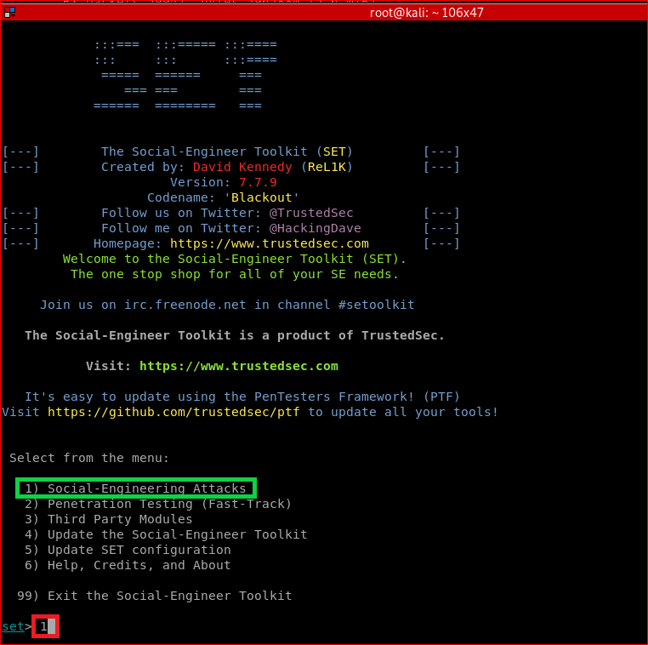
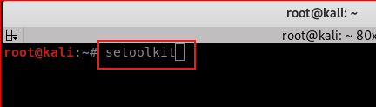

Slide 4
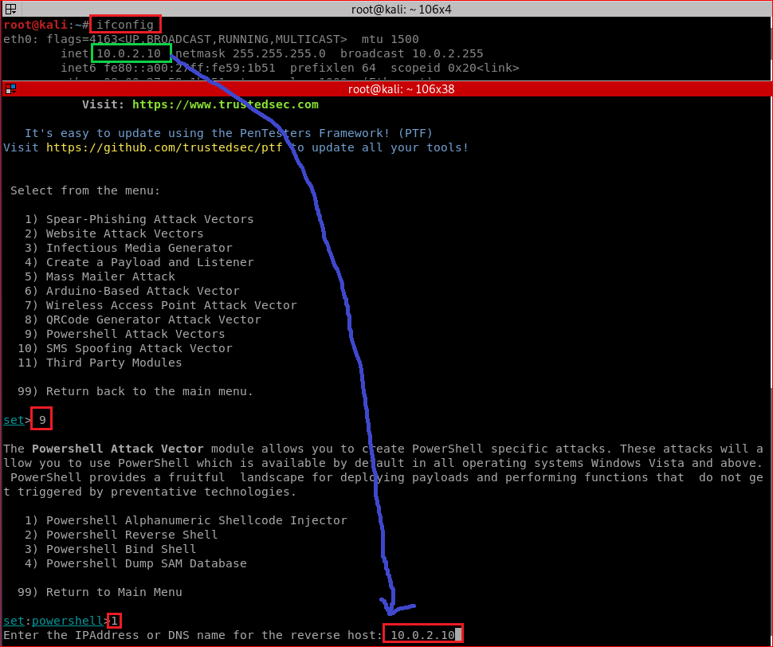

Slide 5
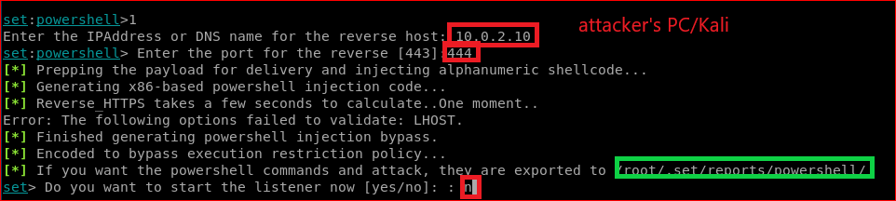

Slide 6
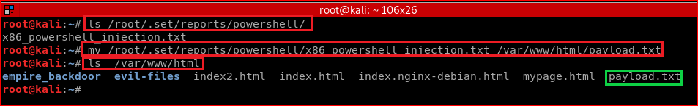

Slide 7
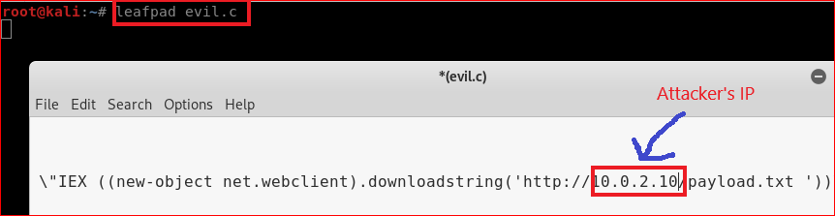

Slide 8
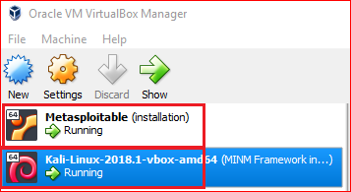

Slide 9
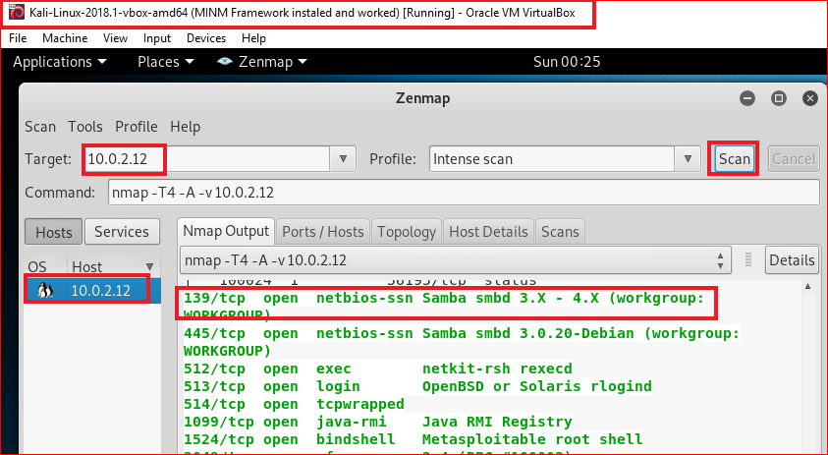

Slide 10
Search potential vulnerabilities

Slide 11
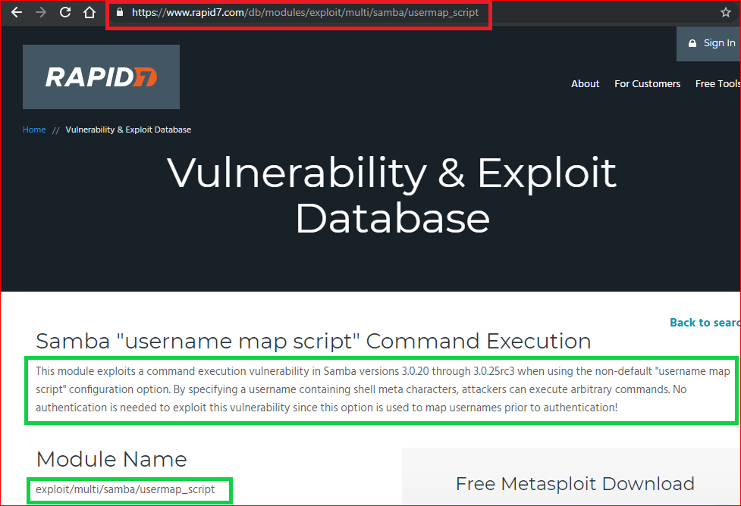

Slide 12
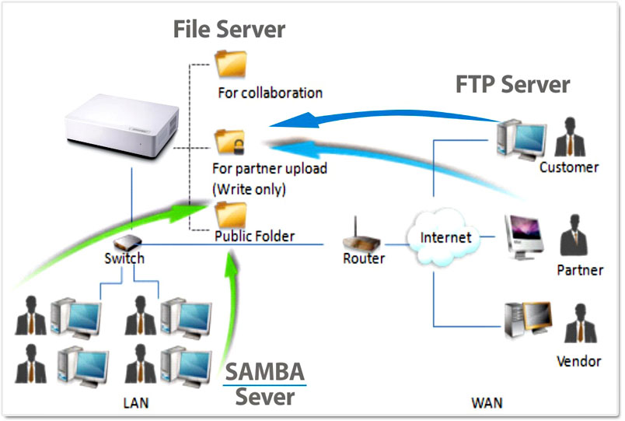
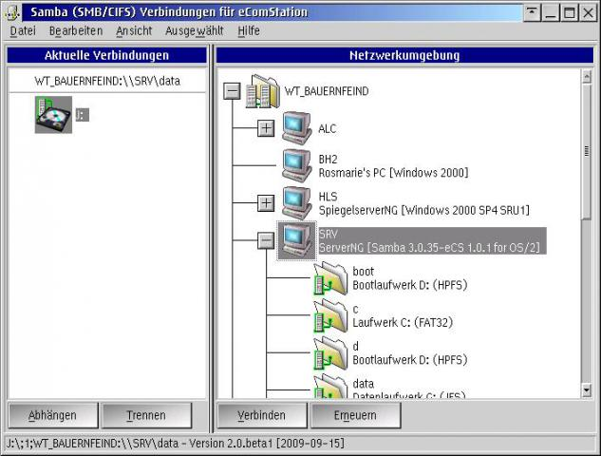
What is Samba?
A software, Samba, provides file and print services for various Microsoft Windows & Linux clients

Slide 13
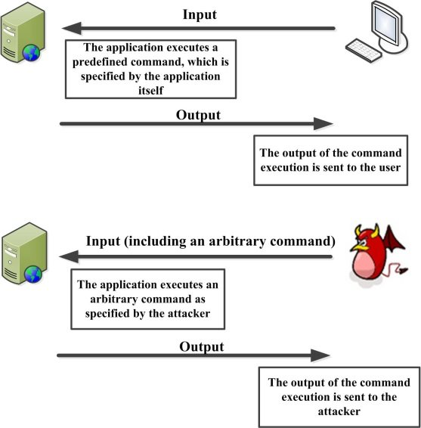
Command injection
An attack in which the goal is execution of arbitrary commands on the host operating system via a vulnerable application.
When an application passes unsafe user supplied data (forms, cookies, HTTP headers etc.) to a system shell.
https://www.researchgate.net/figure/Command-injection-attacks_fig1_322875799

Slide 14
Inject commands to Samba

Slide 15
Injection details
Samba is running on servers
We inject arbitrary commands to Samba
Commands allow malicious users (e.g., Kali) to gain controls to the servers

Slide 16
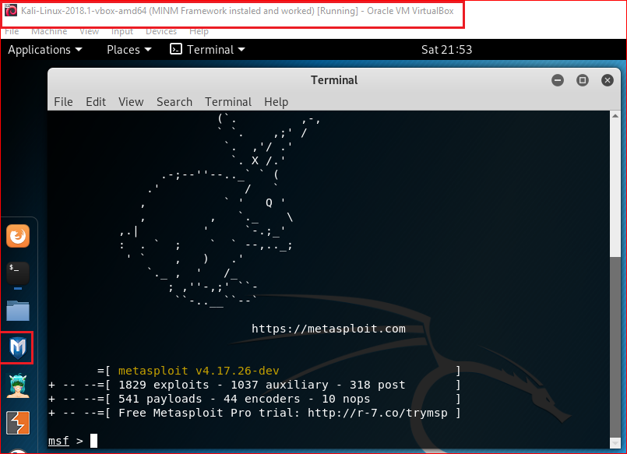
msfconsole
Notes:
Msf
consle

Slide 17
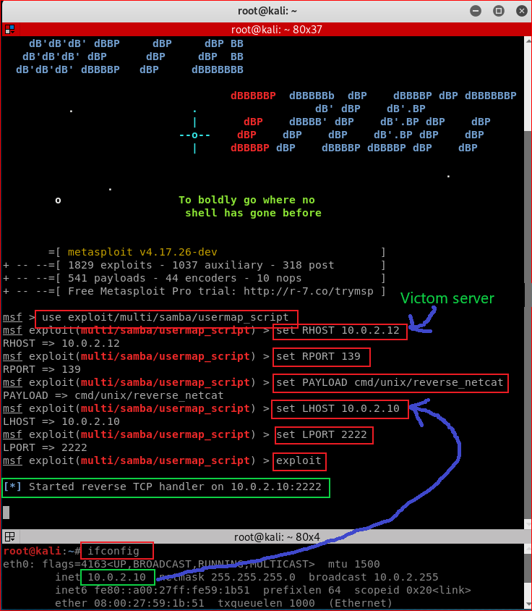

Slide 18
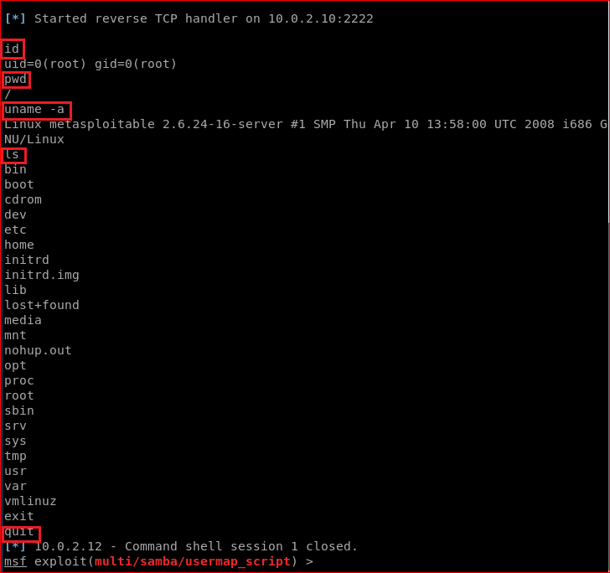

Slide 19

server side forensics using firewall

Slide 20
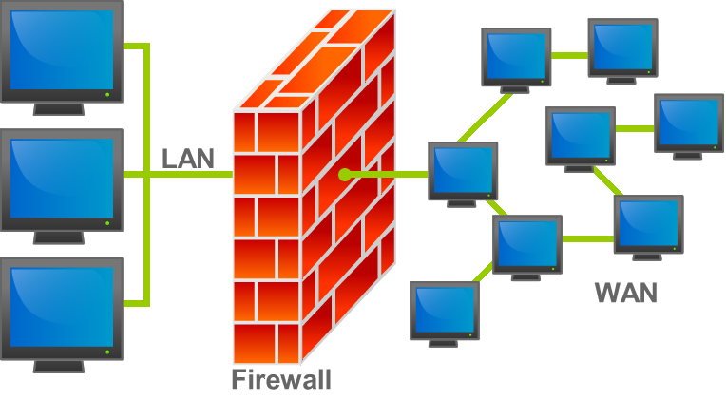
What is a firewall
https://en.wikipedia.org/wiki/File:Firewall.png

Slide 21
Create a rule for monitoring traffics
Your job is to find forensic evidence.
The evidence will tell us when intruder’s IP.

Slide 22
Reference
https://null-byte.wonderhowto.com/how-to/bypass-antivirus-using-powershell-and-metasploit-kali-tutorial-0167601/
https://null-byte.wonderhowto.com/how-to/hide-virus-inside-fake-picture-0168183/
https://www.sans.org/cyber-security-summit/archives/file/summit-archive-1492186586.pdf

